Slide 1
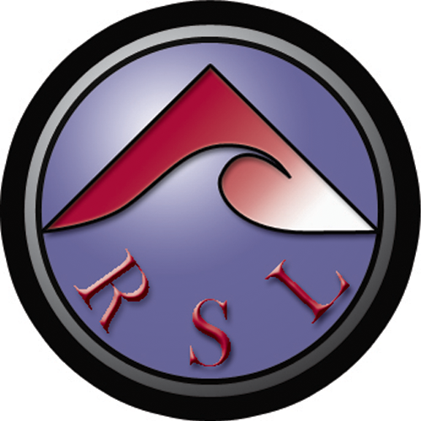
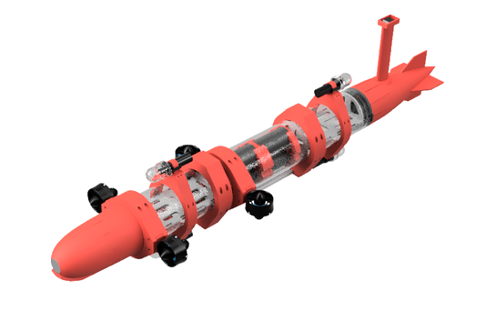
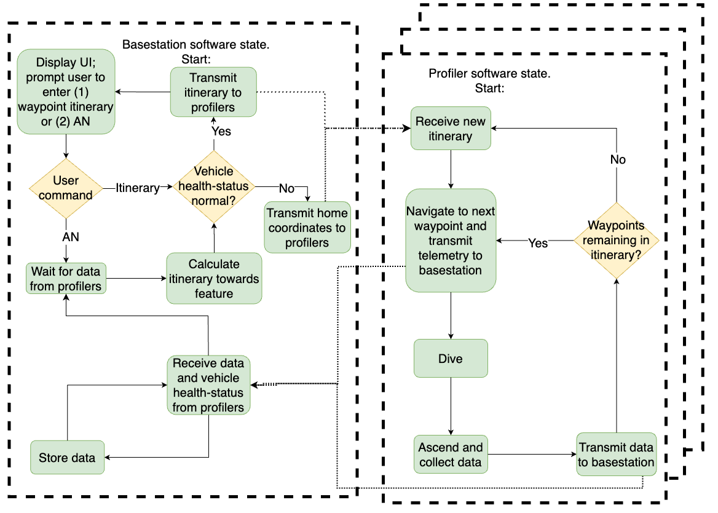
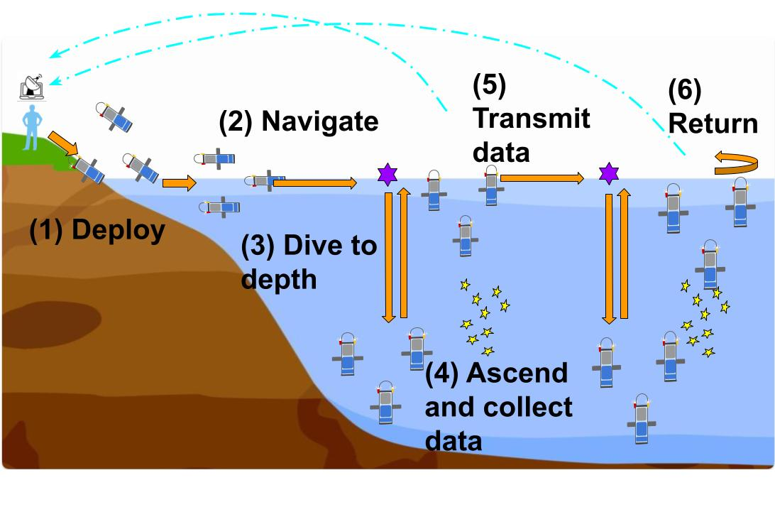
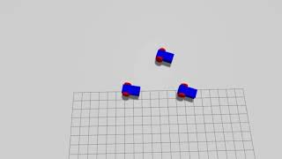
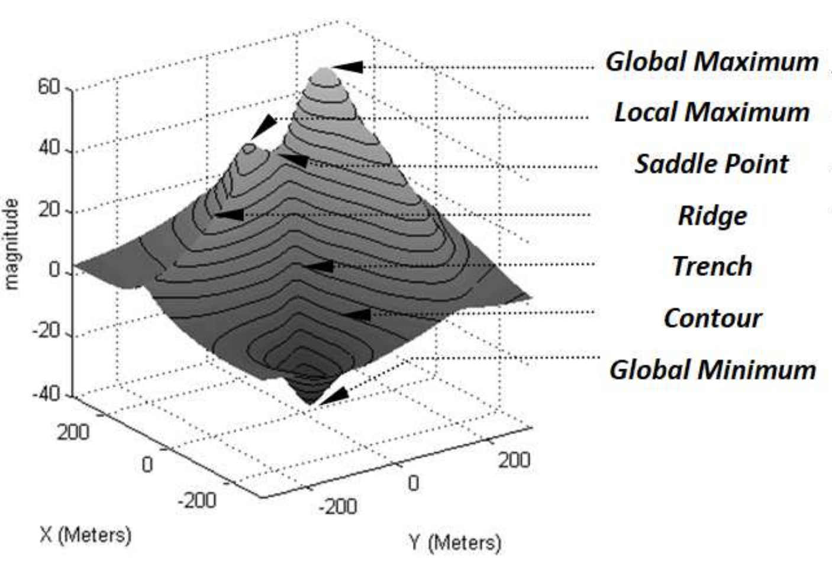
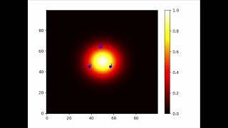
Novel Control Law and Robotic Vehicle for Pinpointing Aquatic Scalar-field Extremums
Authors: Jeffrey Ke (jke@scu.edu), Alexander Collins, Ricky Schober, Kevin Wang Advisors: Dr. Christopher Kitts, Dr. Michael Neumann
Abstract
Background
Abstract
Vehicle Design
We present a novel control law and robotic vehicle that autonomously pinpoints and navigates to aquatic scalar-field extremums using multi-robot scalar field adaptive navigation (SFAN). We expand the Robotic Systems Lab existing corpus on this subject by developing a variant of multi-robot SFAN that uses sensor measurements taken at discrete time-steps. Real-world sensors, especially aquatic ones, often require time between measurements, preventing continuous, rapid-fire sampling of the environment.
Multi-robot SFAN uses a squadron of mobile robots to take scalar sensor-readings of their surroundings at every time-step and use it to calculate the trajectory to arrive at their target destination. In collaboration with the U.S. Army Corps of Engineers, we aim to deploy these algorithms in our retrofitted profilers to hunt down migrating clouds of underwater pollutants that smother sensitive marine life.
State-Machine
Simulated Cluster Control
Figure 1: Concept of Operations
Scalar Fields
Initial Simulated Trials
Future Work
Pinpointing additional scalar-field features:
Saddle-points
Ridges
Trenches
Contours
Internal battery-charging
Figure 2: Archetypal scalar-field
Acknowledgements
SCU Robotics Systems Laboratory
Thomas Heckman
SCU School of Engineering

